Slide 1

BrideBook
A/B test And Analytics

Slide 2
Objectives
Task overview
A/B Testing
EDA
PCA
Summary
Business Future Recommendations

Slide 3
OverView
Variant 0 Control Group
The product team wants more registered users to browse for venues and inquire.
By creating A/B test with three variants
Variant 1 Treatment group 1
Variant 2 Treatment group 2

Slide 4

Vital Questions will be answered
What was the outcome of this test?
What business recommendations would you suggest off the back of the results?
Are there any other findings/suggestions that come from the data?
What additional questions would you want to investigate given more time/data?
Any other comments or improvements that come to mind.

Slide 5

A/B Test
Hypothesis H0: Old and new pages are statistically indistinguishable.
H1: Control group and 2 treatment groups variation 1 and 2 of finalising operation differ significantly between groups’ pages

Slide 6
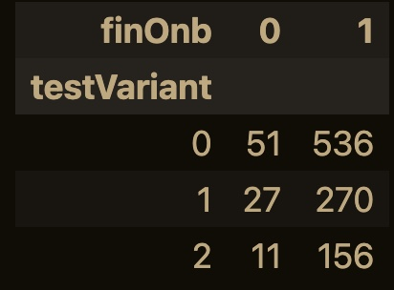
Contingency table by crosstab function shows:
users who finalized op from control group are 536,
treatment group one with testVarint 1 is 270,
and treatment group two with testVarint 2 is 156.

Slide 7
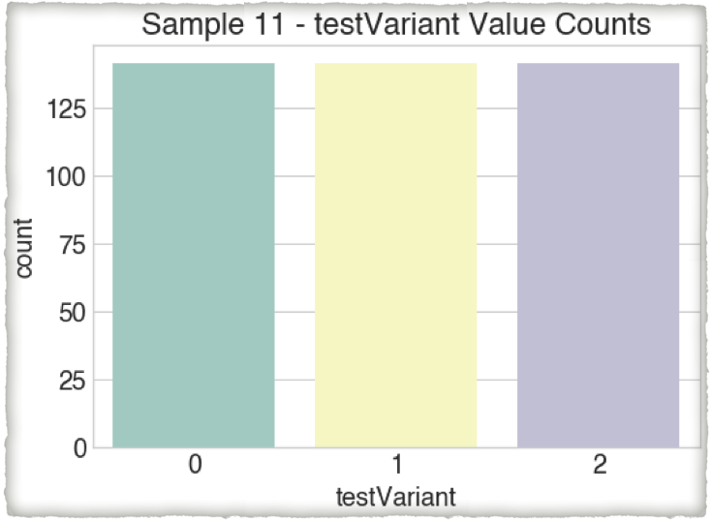
Proceeding with random sampling
3 groups, 10 samples Size as shown

Slide 8
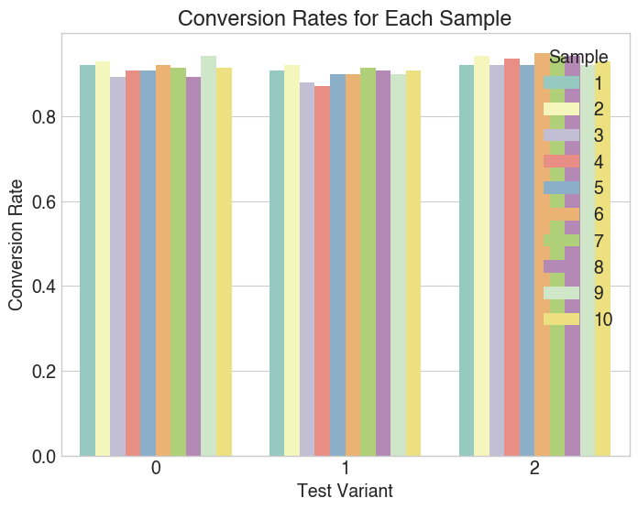
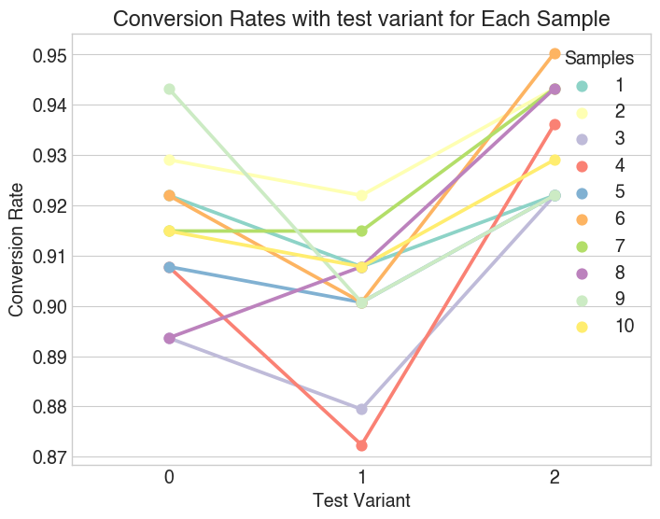
Checking conversion rates and plot it with multipe Random Sampling and calculating
Values will be continued further on
Conversion Rate:

Slide 9
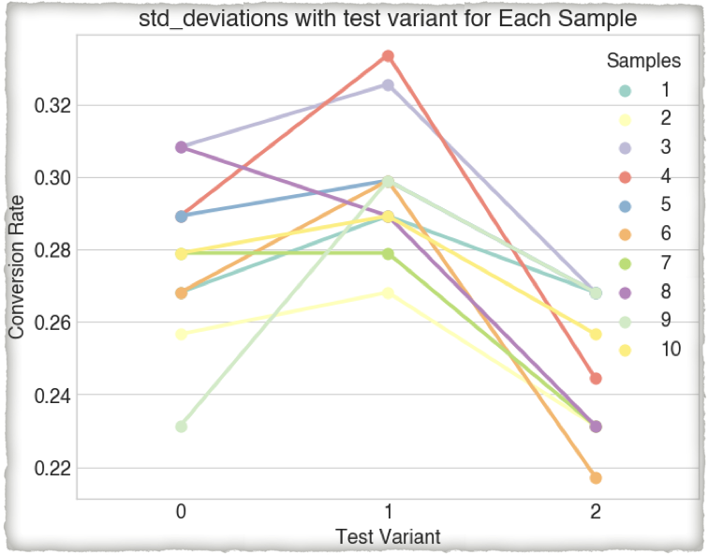
Variant 2 has consistent deviation values, while variant 1 has discrepancies.
Standard Deviation

Slide 10
rates imply that 95% and 92% of total visits on our digital assets resulted in the intended user actions, as variant 2 in our case hid the text of variant 2
Conversion Rate:

Slide 11
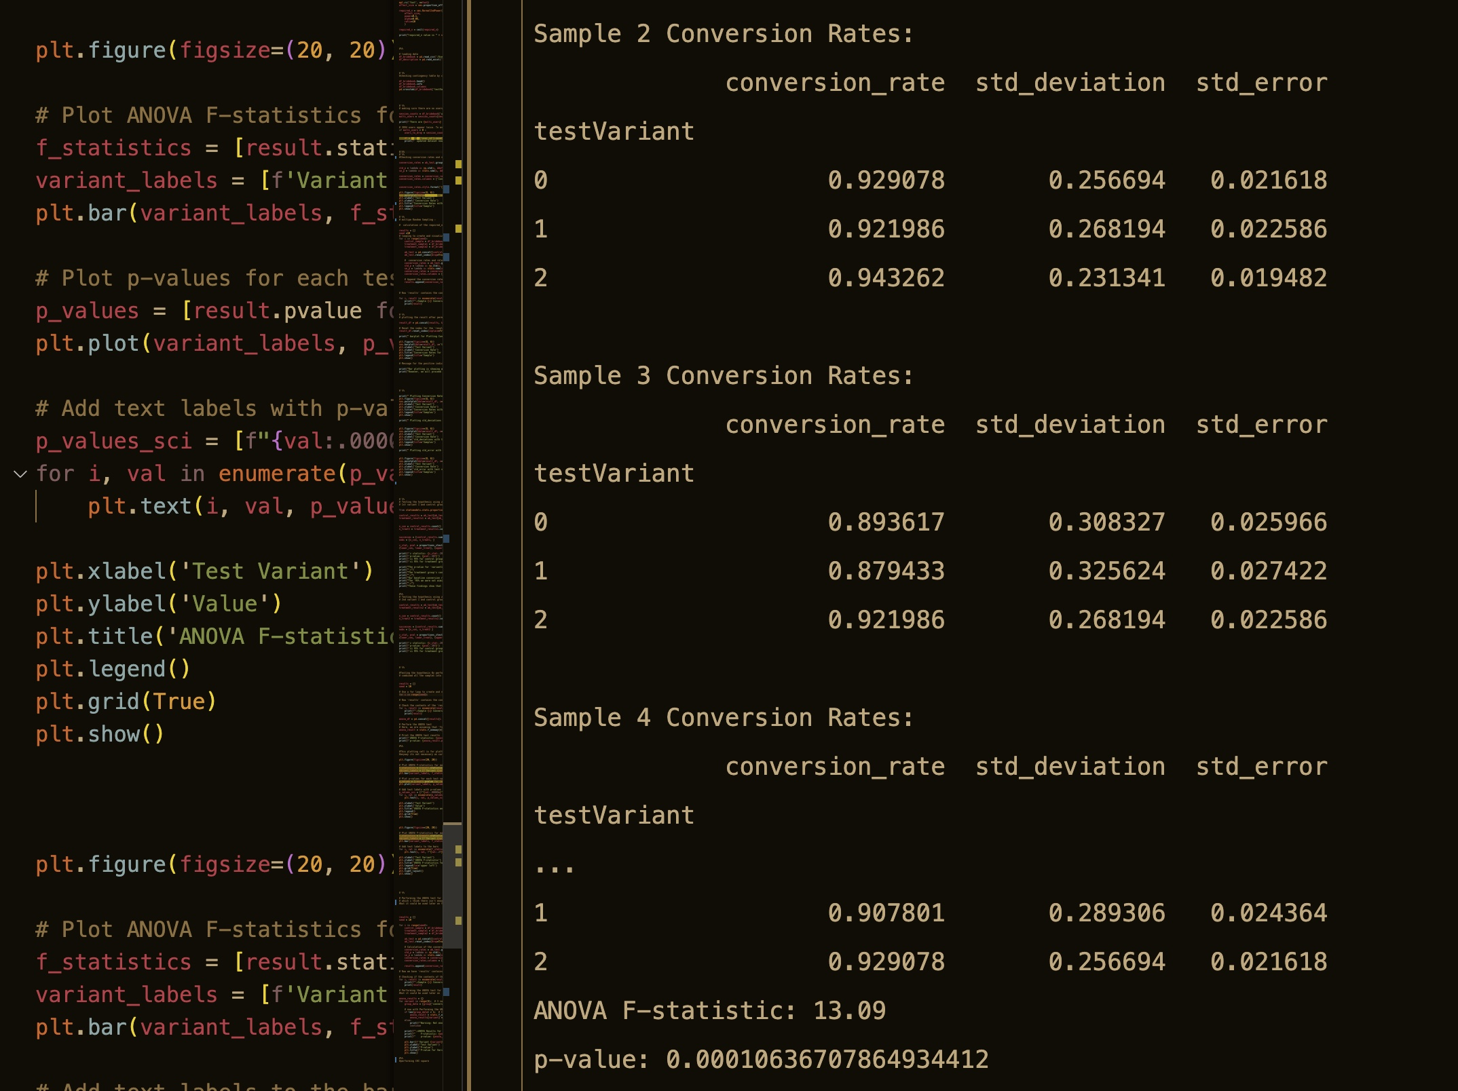
ANOVA F-statistic: Compares group means to variability. F-statistic 13.09. A higher F-statistic indicates a greater difference between group means than group variance.
P-value: the probability of receiving the reported results (or worse) assuming no genuine difference between group means. It's 0.00010636707864934412. This p-value (less than 0.05) suggests statistically significant group mean variation.
Hypothesis testing:

Slide 12
I will Update the representation with the rest of the results and insights and Business recommendations before our nextthe meeting. Technical report will be available with all details. To be Followed up. Thanks,

